Slide 1
SOLID Principle
Overview
https://www.youtube.com/watch?v=HLFbeC78YlU&list=PL6n9fhu94yhXjG1w2blMXUzyDrZ_eyOme&ab_channel=kudvenkat
https://csharp-video-tutorials.blogspot.com/2018/01/solid-design-principles.html

Slide 2
Introduction
SOLID principle are the design principle that enable us manage\solve most of the software design problems.
The term SOLID is an acronym for five design principle indented to make software designs more understandable, flexible and maintainable
The principle are a subset of many principle promoted by Robert C.Martin
The SOLID acronym was first introduced by Michael Feathers

Slide 3
SOLID Principle
S - Single Responsibility Principle (SRP)
O - Open-closed Principle (OCP)
L - Liskov substitution Principle (LSP)
I - Interface Segregation Principle (ISP)
D - Dependency Inversion Principle (DIP)

Slide 4
If we don’t follow SOLID Principles, we
End up with tight or strong coupling of the code with many other modules/applications
Tight coupling causes time to implement any new requirement, features or any bug fixes and sometimes it creates unknown issues
End up with a code which is not testable
End up with duplication of code
End up creating new bugs by fixing another bug
End up with many unknown issues in the application development cycle

Slide 5
Tight coupling Problem Example
Tight Coupling Code | Loose Coupling Code
public class User { public string Username { get; set; } public string Password { get; set; } } public class Authenticator { private User _user; public Authenticator() { _user = new User { Username = "admin", Password = "password" }; } public bool Authenticate(string username, string password) { if (username == _user.Username && password == _user.Password) { return true; } return false; } } | public class User { public string Username { get; set; } public string Password { get; set; } } public class Authenticator { private User _user; public Authenticator(User user) { _user = user; } public bool Authenticate(string username, string password) { if (username == _user.Username && password == _user.Password) { return true; } return false; } }

Slide 6
Tight Coupling Code | Loose Coupling Code
public class Television { public void Start() { Console.WriteLine("Television is started!"); } } public class Remote { private Television Tv { get; set; } protected Remote() { Tv = new Television(); } static Remote() { _remoteController = new Remote(); } static Remote _remoteController; public static Remote Control { get { return _remoteController; } } public void RunTv() { Tv.Start(); } } | public interface IRemote { void Run(); } public class Television : IRemote { protected Television() { } static Television() { _television = new Television(); } private static Television _television; public static Television Instance { get { return _television; } } public void Run() { Console.WriteLine("Television is started!"); } } public class Remote { IRemote _remote; public Remote(IRemote remote) { _remote = remote; } public void Run() { _remote.Run(); } }

Slide 7
class Program { static void Main(string[] args) {
Remote remote = new Remote(Television.Instance); remote.Run(); Console.Read(); } }

Slide 8
Difference Between Loose Coupling and Tight Coupling?
Loose Coupling means reducing dependencies of a class that use a different class directly.
In tight coupling, classes and objects are dependent on one another.
In general, tight coupling is usually bad because it reduces flexibility and re-usability of code and it makes changes much more difficult and impedes testability etc.
Loose Coupling Advantages:- It will save you a lot of time for any project that isn't trivially small, where I define trivially small as less than a couple thousand lines of code (depending on the language). The reason is that once you get past super small projects, each change or update gets harder the more tightly coupled it is. Being loosely coupled enables you to keep moving forward, adding features, fixing bugs, etc.

Slide 9
Following SOLID Principles helps us to
Achieve reduction in complexity of code
Increase readability, extensibility and maintenance
Reduce error and implement Reusability
Achieve Better testability
Reduce tight coupling

Slide 10
Solution to develop a successful application depends on
Architecture : choosing an architecture is the first step in designing application based on the requirements. Example : MVC, WEBAPI, MVVM..etc
Design Principles : Application development process need to follow the design principles
Design Patterns : We need to choose correct design patterns to build the software

Slide 11
Single Responsibility Principle (SRP)
Robert C. Martin expresses the principle as, "A class should have only one reason to change”
Every module or class should have responsibility over a single part of the functionality provided by the software, and that responsibility should be entirely encapsulated by the class.

Slide 12
Single Responsibility Principle (SRP)
Each class and module should focus on a single task at a time
Everything in the class should be related to that single purpose
There can be many members in the class as long as they related to the single responsibility
With SRP, classes become smaller and cleaner
Code is less fragile

Slide 13
SRP Implementation Guideline

Slide 14
SRP Example
interface IUser
{
bool Login(string username, string password);
bool Register(string username, string password, string email);
}
interface ILogger
{
void LogError(string error);
}
interface IEmail
{
bool SendEmail(string emailContent);
}

Slide 15
SRP Example continue…..
public class PermanentEmployee : Employee
{
public PermanentEmployee()
{ }
public PermanentEmployee(int id, string name) : base(id, name)
{ }
public override decimal CalculateBonus(decimal salary)
{
return salary * .1M;
}
}
public class TemporaryEmployee : Employee
{
public TemporaryEmployee()
{ }
public TemporaryEmployee(int id, string name) : base(id, name)
{ }
public override decimal CalculateBonus(decimal salary)
{
return salary * .05M;
}
}

Slide 16
Open-closed Principle (OCP)
“Software entities such as classes, modules, functions etc. should be open for extension, but closed for modification”
Any new functionality should be implemented by adding new classes, attributes and methods, instead of changing the current ones or existing ones.
The design and writing of the code should be done in a way that new functionality should be added with minimum changes in the existing code
The design should be done in a way to allow the adding of new functionality as new classes, keeping as much as possible existing code unchanged
Bertrand Meyer originated the term OCP
Robert C. Martin considered this as most important principle

Slide 17
Why OPC?
If Not followed
End up testing the entire functionality
QA Team need to test the entire flow
Costly Process for the Organization
Breaks the Single responsibility as well
Maintenance overheads increase on the classes

Slide 18
OPC Implementation Guideline
How to achieve OCP
Abstract class

Slide 19
OPC Example
public abstract class Employee
{
public int ID { get; set; }
public string Name { get; set; }
public Employee()
{
}
public Employee(int id, string name)
{
this.ID = id; this.Name = name;
}
public abstract decimal CalculateBonus(decimal salary);
public override string ToString()
{
return string.Format("ID : {0} Name : {1}", this.ID, this.Name);
}
}

Slide 20
Liskov Substitution Principle (LSP)
Introduced by Barbara Liskov state that “objects in a program should be replaceable with instances of their sub-types without altering the correctness of that program”
If a program module is using a Base class, then the reference to the Base class can be replaced with a Derived class without affecting the functionality of the program module
We can also state that Derived types must be substitutable for their base types.

Slide 21
Liskov substitution Principle (LSP)
Substitutability is a principle in object-oriented programming and it states that, in a computer program, if S is a Subtype of T, then objects of type T may be replaced with objects of type S
Which means, Derived types must be completely substitutable for their base types
More formally, the Liskov substitution principle (LSP) is a particular definition of a subtyping relation, called (strong) behavioral subtyping
This Principle is introduced by Barbara Liskov in 1987 during her conference address on Data abstraction and hierarchy
This principle is just an extension of the Open Close Principle

Slide 22
LSP Implementation Guideline
No new exceptions can be thrown by the subtype unless they are part of the existing exception hierarchy.
We should also ensure that Clients should not know which specific subtype they are calling, nor should they need to know that. The client should behave the same regardless of the subtype instance that it is given.
And last but not the least, New derived classes just extend without replacing the functionality of old classes

Slide 23
LSP Example
interface IEmployee
{
int ID { get; set; }
string Name { get; set; }
decimal GetMinimumSalary();
}
interface IEmployeeBonus
{
decimal CalculateBonus(decimal salary);
}

Slide 24
LSP Example
public class PermanentEmployee : Employee
{
public PermanentEmployee()
{ }
public PermanentEmployee(int id, string name) : base(id, name)
{ }
public override decimal CalculateBonus(decimal salary)
{
return (salary * .1M);
}
public override decimal GetMinimumSalary()
{
return 15000;
}
}

Slide 25
LSP Example
public class TemporaryEmployee : Employee
{
public TemporaryEmployee()
{ }
public TemporaryEmployee(int id, string name) : base(id, name)
{ }
public override decimal CalculateBonus(decimal salary)
{
return (salary * .05M);
}
public override decimal GetMinimumSalary()
{
return 5000;
}
}

Slide 26
LSP Example
public class ContractEmployee : IEmployee
{
public int ID { get; set; }
public string Name { get; set; }
public ContractEmployee()
{ }
public ContractEmployee(int id, string name)
{
this.ID = id;
this.Name = name;
}
public decimal GetMinimumSalary()
{
return 5000;
}
public override string ToString()
{
return string.Format("ID : {0} Name : {1}", this.ID, this.Name);
}
}

Slide 27
LSP Example
static void Main(string[] args)
{
List<Employee> employees = new List<Employee>();
employees.Add(new PermanentEmployee(1, "John"));
employees.Add(new TemporaryEmployee(2, "Jason"));
//Un Comment to see the error
//employees.Add(new ContractEmployee(3, "Mike"));
foreach (var employee in employees)
{
Console.WriteLine(string.Format("Employee {0} Bonus: {1} MinSalary: {2}",
employee.ToString(),
employee.CalculateBonus(100000).ToString(),
employee.GetMinimumSalary().ToString()));
}
Console.WriteLine();
List<IEmployee> employeesOnly = new List<IEmployee>();
employeesOnly.Add(new PermanentEmployee(1, "John"));
employeesOnly.Add(new TemporaryEmployee(2, "Jason"));
employeesOnly.Add(new ContractEmployee(3, "Mike"));
foreach (var employee in employeesOnly)
{
Console.WriteLine(string.Format("Employee {0} MinSalary: {1}",
employee.ToString(),
employee.GetMinimumSalary().ToString()));
}
Console.ReadLine();
}

Slide 28
Interface Segregation Principle (ISP)
“Many client-specific interfaces are better than one general-purpose interface”
We should not enforce clients to implement interfaces that they don't use. Instead of creating one big interface we can break down it to smaller interfaces
One big fat interface segregation to smaller relevant interfaces is called ISP.

Slide 29
ISP Implementation Guideline
Separate Interface

Slide 30
ISP Example
interface IPrintScanContent
{
bool PrintContent(string content);
bool ScanContent(string content);
bool PhotoCopyContent(string content);
}
interface IFaxContent
{
bool FaxContent(string content);
}
interface IPrintDuplex
{
bool PrintDuplexContent(string content);
}

Slide 31
Dependency Inversion Principle (DIP)
High-level modules should not depend on low level modules. Both should depend on abstraction.
Abstractions should not depend on details. Details should depend on abstractions.
One should “depend upon abstractions, [not] concretions"
Abstractions should not depend on the details whereas the details should depend on abstractions.
To simplify this we can state that while designing the interaction between a high-level module and a low-level one, the interaction should be thought of as an abstract interaction between them.

Slide 32
DIP Implementation Guideline
Interfaces over implementation: Depend on Interfaces rather than concrete implementations. This allows for interchangeable dependencies
Dependency Injection: Instead of directly creating and managing dependencies within a class, inject them from external sources.
Use Interfaces or Abstract Classes: Define abstractions for dependencies, and have classes depend on these interfaces or abstract classes rather than concrete implementations.

Slide 33
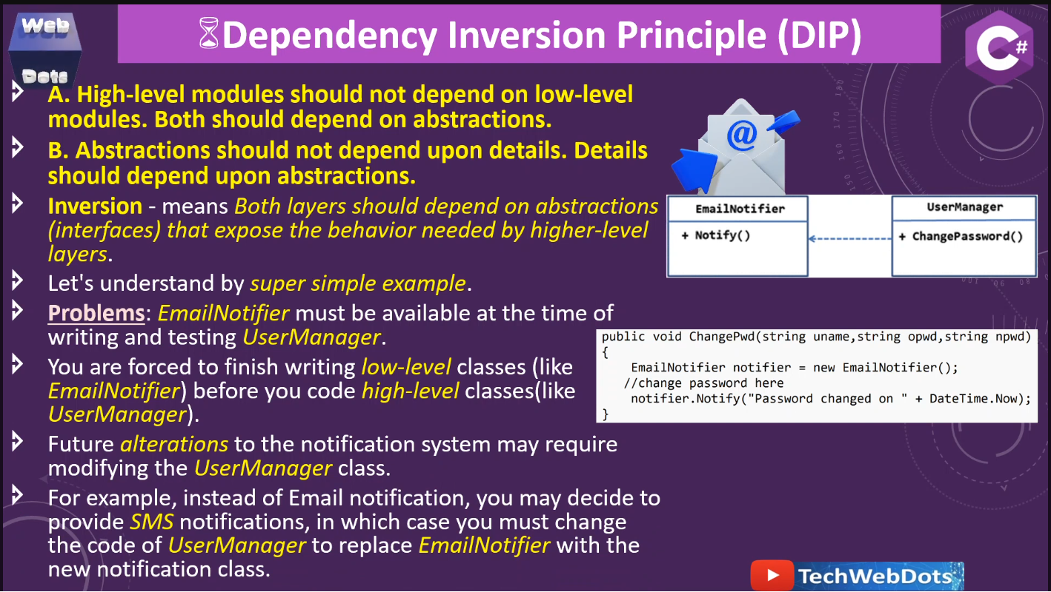
Dependency Inversion Principle (DIP)

Slide 34
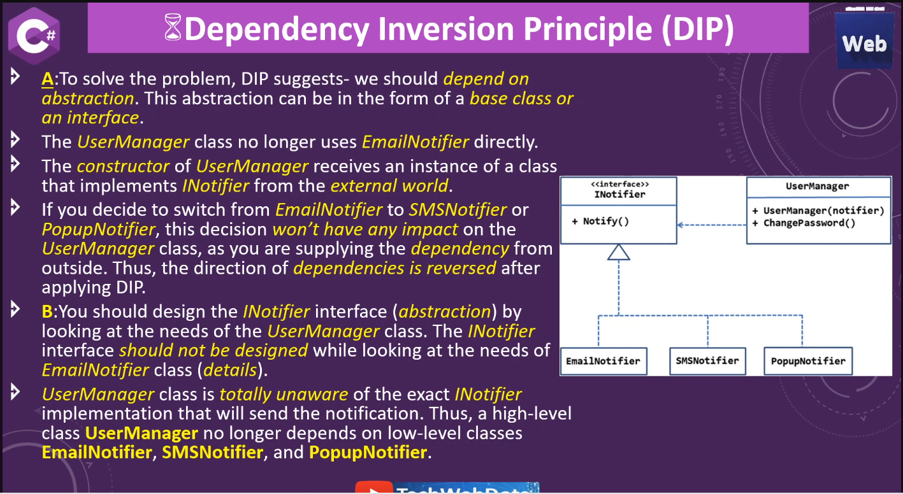
Dependency Inversion Principle (DIP)

Slide 35
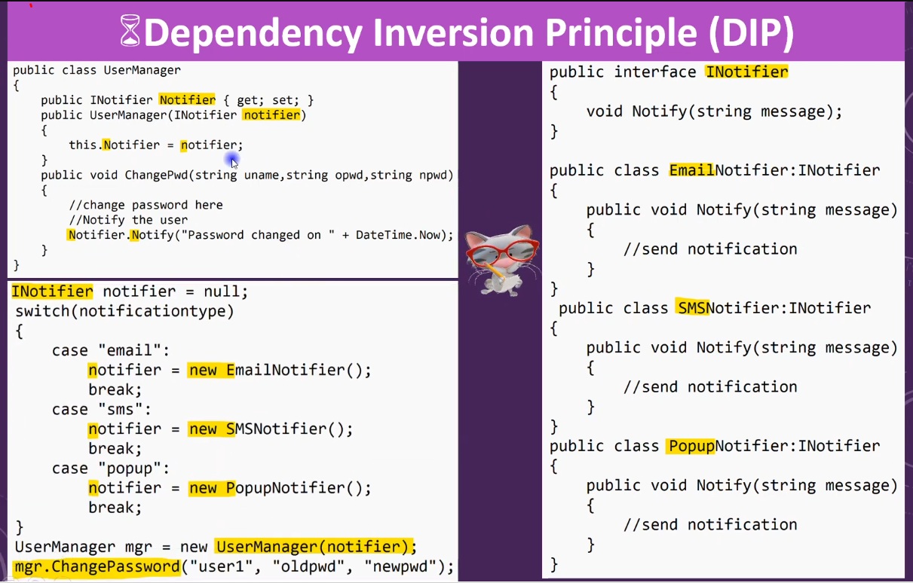
DIP Example

Slide 36
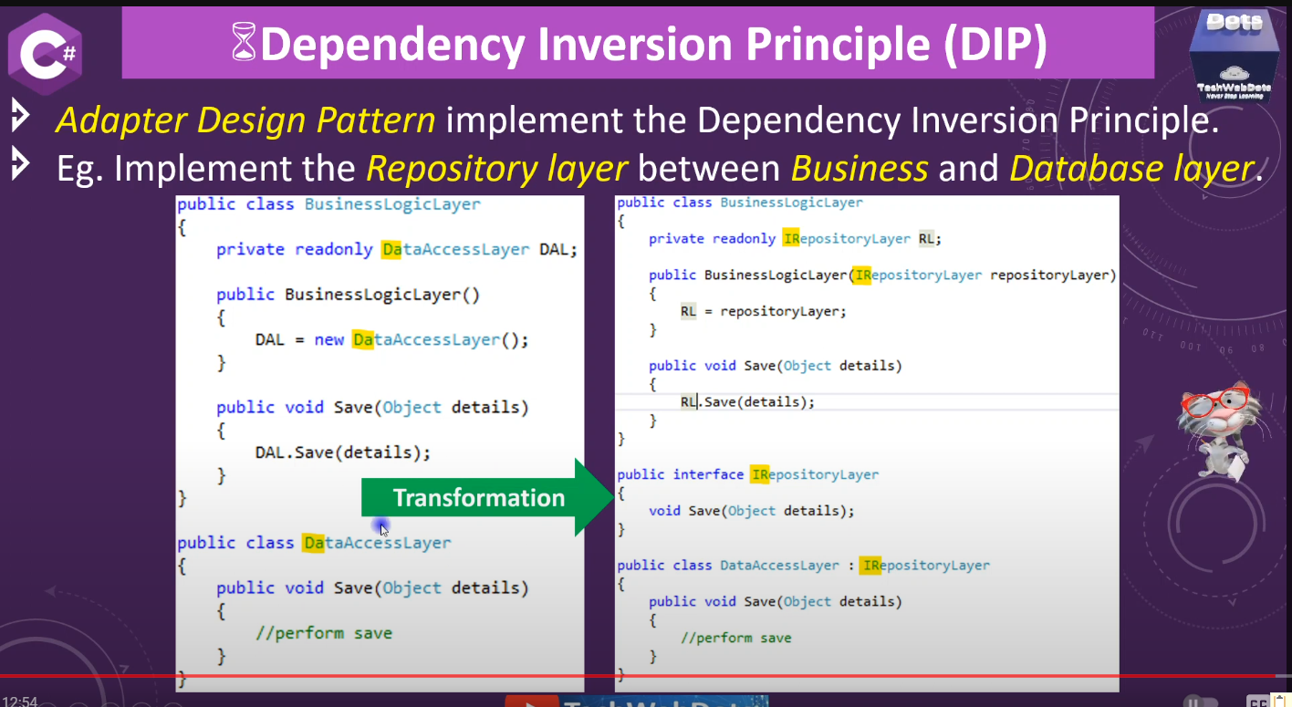
DIP Example

Slide 37
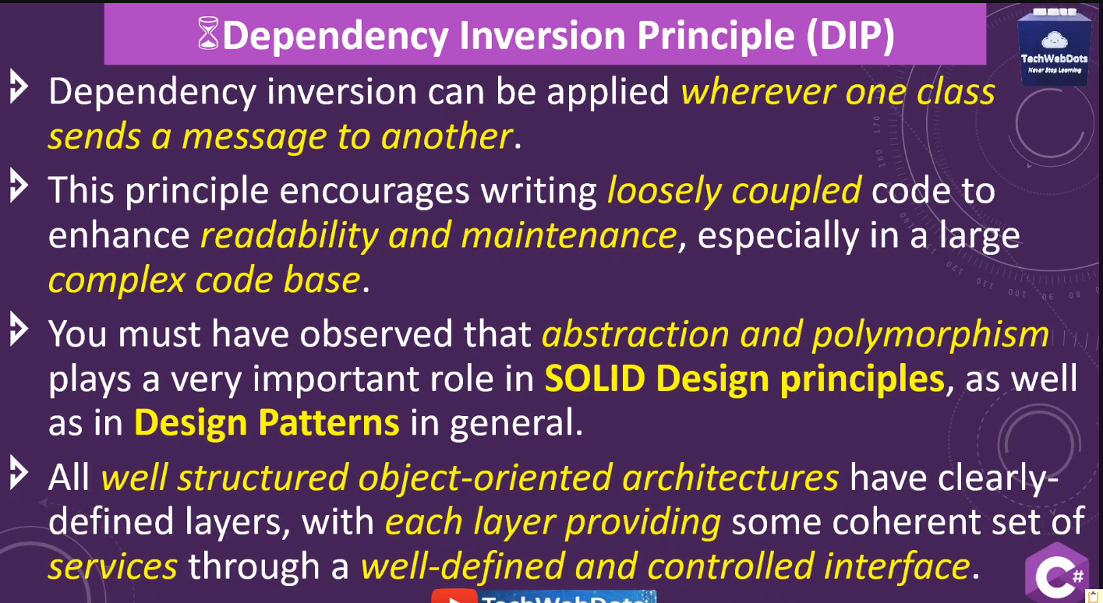
Dependency Inversion Principle (DIP)

Slide 38
Dependency Inversion vs Dependency Injection
Dependency Inversion is a design principle that guides the structure of your code.
Dependency Injection is a specific technique to implement Dependency Inversion by injecting dependencies from the outside rather than creating them internally.
Dependency Inversion outlines the principle of depending on abstractions rather than concrete implementations.
Dependency Injection is a technique to implement DIP, allowing dependencies to be injected into classes.

Slide 39
Dependency Inversion vs Dependency Injection
public interface IBookRepository { Book GetBookById(int id); void SaveBook(Book book); // Other methods related to book persistence } public class BookService { private IBookRepository bookRepository; public BookService(IBookRepository bookRepository) { this.bookRepository = bookRepository; } public Book GetBookById(int id) { return bookRepository.GetBookById(id); } public void AddNewBook(Book book) { bookRepository.SaveBook(book); } } | public class DatabaseBookRepository : IBookRepository { //Implement methods to interact with a database for book operations // ... } class Program { static void Main(string[] args) { //Injecting DatabaseBookRepository dependency into BookService IBookRepository bookRepository = new DatabaseBookRepository(); BookService bookService = new BookService(bookRepository); // Using BookService to get a book by ID and add a new book Book book = bookService.GetBookById(1); bookService.AddNewBook(new Book()); } }

